Slide 1
Students Performance
Dashboard
PROJECT BRIEF
A three-page Power BI report on 397 students from two schools: how family, study habits and lifestyle relate to grades, absences and passing.
Source data: Student_perf.xlsx · 35 columns · schools GP and MS

Slide 2
The problem we solved
THE PROJECT
The problem
What we built
What it gives the school
One flat sheet: 397 students and 35 columns. Grades, family, habits and absences sit side by side, grades are split over three subjects (Sub1 to Sub3), and many answers are codes from 1 to 5.
A three-page Power BI report with slicers for address, age, school and gender, and measures for student counts, average absences, average grades, pass or fail, High Risk and Perfect Healthy students.
One place to see who the students are, which home and study conditions go with passing, and how diet, sleep and alcohol relate to results.
Students Performance Dashboard · Project brief · 2

Slide 3
What is in the sheet
THE DATA
397
35
350 / 47
15 to 22
students (rows)
columns
students in GP / MS
age range
Student · 4
Family · 9
School life · 10
school, sex, age, address
famsize, Pstatus, Medu, Fedu, Mjob, Fjob, guardian, famrel, famsup
reason, traveltime, studytime, failures, schoolsup, paid, activities, nursery, higher, internet
Lifestyle · 8
Results · 4
freetime, goout, Dalc, Walc, health, romantic, Sleep Duration, Dietary Habits
absences, Sub1, Sub2, Sub3
Students Performance Dashboard · Project brief · 3

Slide 4
Three pages, three questions
THE REPORT
#
Page
The question it answers
Main visuals
1
Student profile
Who are the students, and how do the two schools compare?
School split, reasons, travel time, absences, grades
2
Family and study
Which family and study conditions go with passing?
Guardian, family relations, paid classes, internet, study time, failures
3
Health and lifestyle
How do diet, sleep and alcohol relate to pass or fail?
Diet, sleep, weekend alcohol, health, free time
Students Performance Dashboard · Project brief · 4

Slide 5
One red family, one highlight
COLOR SYSTEM
Canvas
Card
Crimson
Maroon
#20232A
#F4F4EF
#A01D26
#6B2328
Dashboard background
Chart cards and slicers
Card headers, KPI values, main series
Largest or darkest category
Rose
Dusty rose
Pink
Orange
#D64550
#B96E73
#EFB5B9
#E66C37
Second series, such as course or pass
Third series
Smallest or other slices
Highlights such as reputation and Sub1
Students Performance Dashboard · Project brief · 5

Slide 6
Every page reads the same way
PAGE LAYOUT
Title tile
Slicers
KPI cards
Charts
The same rounded Students Performance tile at the top left of every page.
Dropdowns for address, school, age and gender, in the same row on every page.
Four or five cards at the top right: one number each, with a clear label.
Five or six cards below, each with a crimson title that says what is counted.
Same frame on every page
Titles say what is counted
Darker means larger
Readers learn the layout once.
"Count of Students by traveltime" leaves no doubt.
The darkest shade is the biggest group in most charts.
Students Performance Dashboard · Project brief · 6

Slide 7
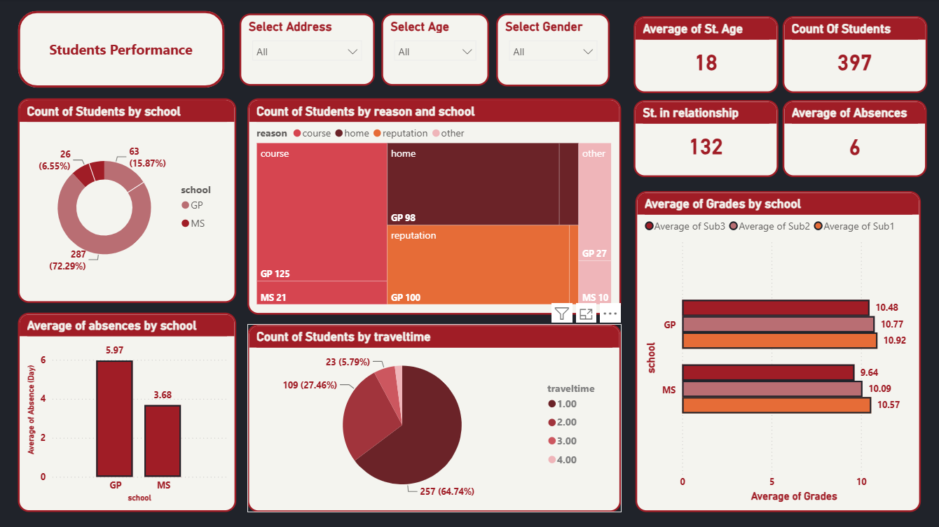

Slide 8
Each visual and its job
PAGE 1 · STUDENT PROFILE
Visual
Chart type
Question it answers
Measures
Slicers
Dropdowns
Which group are we looking at?
Address, Age, Gender
KPI cards
Cards
How big and how engaged is the group?
Average age, student count, students in a relationship, average absences
Students by school
Donut
How are students split between the schools?
Count of students by school
Reason and school
Treemap
Why did students pick their school?
Count by reason (course, home, reputation, other) and school
Absences by school
Column
Which school has more absences?
Average absences per school
Travel time
Pie
How long is the trip to school?
Count of students by travel time
Grades by school
Clustered bar
How do the schools compare in each subject?
Average of Sub1, Sub2, Sub3 per school
Students Performance Dashboard · Project brief · 7

Slide 9
What we learned
PAGE 1 · STUDENT PROFILE
88%
5.97 vs 3.68
3 of 3
of the 397 students attend GP (350 students). MS has 47.
average absences per student in GP versus MS.
subjects where GP leads MS. The gap grows from Sub1 (0.35) to Sub3 (0.84).
146
65%
132
students chose their school for the course. Home follows with 109, reputation 105, other 37.
of students (257) are in the shortest travel-time band. Only 8 are in the longest.
students (33%) are in a relationship.
Students Performance Dashboard · Project brief · 8

Slide 10
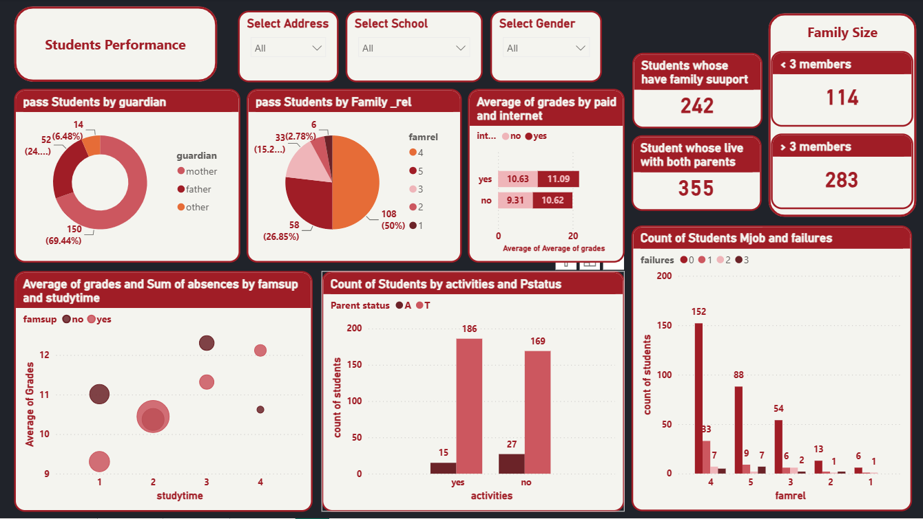

Slide 11
Each visual and its job
PAGE 2 · FAMILY AND STUDY
Visual
Chart type
Question it answers
Measures
Slicers
Dropdowns
Which group are we looking at?
Address, School, Gender
KPI cards
Cards
How much family support and stability is there?
Family support, living with both parents, family size
Pass by guardian
Donut
Who looks after students who pass?
Passing students by guardian
Pass by family relations
Pie
Do good family relations go with passing?
Passing students by family relationship (1 to 5)
Grades by paid and internet
Bar
Do paid classes and internet go with higher grades?
Average grades by paid classes and internet
Grades and study time
Bubble
Does study time or family support move grades?
Average grades by study time and family support, bubble size = absences
Activities and parent status
Clustered column
Do activities and parents living together go together?
Count by activities and parent status (A or T)
Students Performance Dashboard · Project brief · 9

Slide 12
What we learned
PAGE 2 · FAMILY AND STUDY
61%
89%
283 vs 114
of students (242) have educational support from their family.
(355 students) live with both parents.
students come from larger families (more than 3 members) versus smaller ones.
69%
50%
+1.31
of passing students have their mother as guardian: 150 of 216.
of passing students (108) rate their family relations 4 out of 5.
points in average grades for students with internet and no paid classes: 10.62 versus 9.31.
Students Performance Dashboard · Project brief · 10

Slide 13
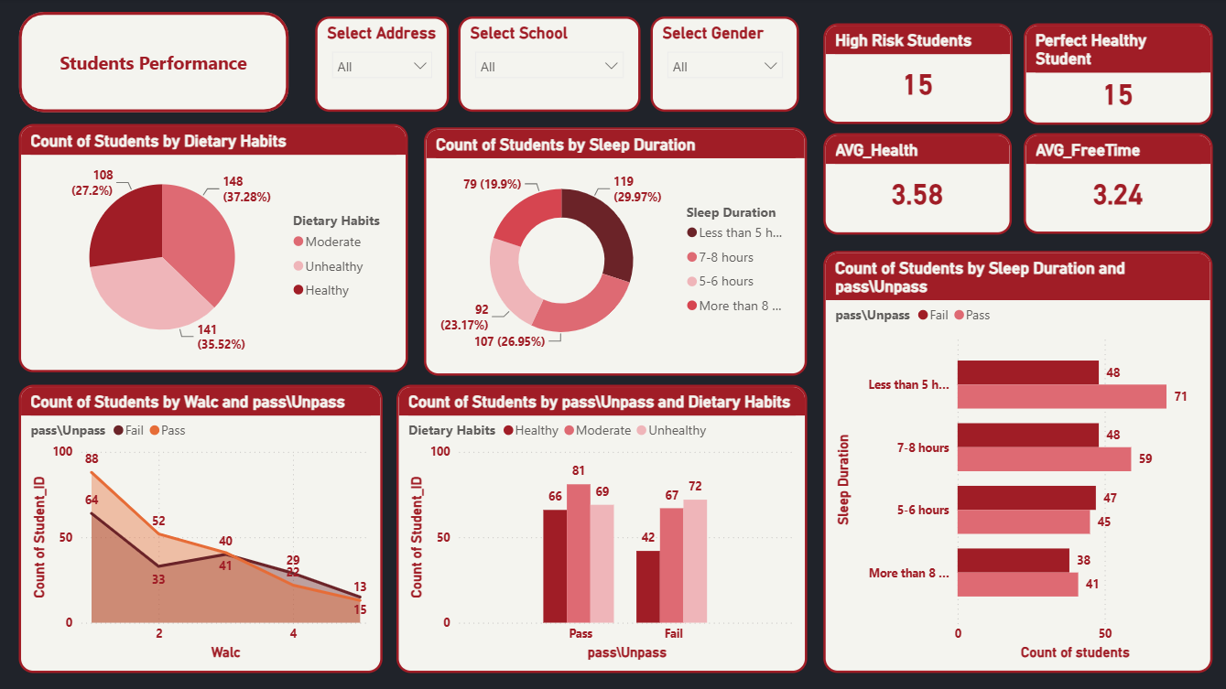

Slide 14
Each visual and its job
PAGE 3 · HEALTH AND LIFESTYLE
Visual
Chart type
Question it answers
Measures
Slicers
Dropdowns
Which group are we looking at?
Address, School, Gender
KPI cards
Cards
Who needs attention, and how healthy is the group?
High Risk, Perfect Healthy, average health, average free time
Dietary habits
Pie
What do students eat?
Count by dietary habits
Sleep duration
Donut
How much do students sleep?
Count by sleep duration
Weekend alcohol
Area
Does weekend drinking relate to pass or fail?
Count by Walc level and pass or fail
Diet and result
Clustered column
Does diet differ between passing and failing students?
Count by pass or fail and dietary habits
Sleep and result
Clustered bar
Does sleep differ between passing and failing students?
Count by sleep duration and pass or fail
Students Performance Dashboard · Project brief · 11

Slide 15
What we learned
PAGE 3 · HEALTH AND LIFESTYLE
27%
61% vs 49%
30%
report a healthy diet (108). Moderate is 148, unhealthy 141.
pass rate with a healthy versus an unhealthy diet: 66 of 108 and 69 of 141.
sleep under 5 hours (119 students), the largest group. 79 sleep more than 8.
71 vs 48
38%
15 and 15
students who sleep under 5 hours pass versus fail. Short sleep alone does not explain failing.
report the lowest weekend alcohol level (152 students). Counts fall at higher levels.
students flagged High Risk and Perfect Healthy by the dashboard cards.
Students Performance Dashboard · Project brief · 12

Slide 16
What the dashboards tell us
IN SHORT
Profile
Family and study
Health and lifestyle
GP holds 88% of students and leads MS in all three subjects, while MS students are absent less often (3.68 against 5.97 days).
Most students have family support (61%) and live with both parents (89%). Internet at home goes with higher grades.
Only 27% eat healthily, and they pass more often (61% against 49%). Sleep under 5 hours is common but not linked to failing.
Students Performance Dashboard · Project brief · 13

